Slide 1

MÜHENDİSLİK FAKÜLTESİ BİLGİSAYAR MÜHENDİSLİĞİ
MUH204 Elektronİk ve UygulamalarI

Slide 2
Bilgisayar Mühendisliği Bölümü
Elektronik ve Uygulamaları – MUH 204
2015-2016 Bahar Yarıyılı
Ders Programı | Teorik Ders | Laboratuvar
Bilgisayar Mühendisliği Bilgisayar Mühendisliği (II.Ö) | Perşembe 9:00-11:50 Perşembe : 19:45-22:50 | (6 deney)
Öğretim Üyeleri: Doç. Dr. Kerem Küçük;
Dr. Öğr. Üyesi Orhan Akbulut;
Referanslar:
1. Fundamentals of Electrical Engineering, L.Bobrow, Oxford, 1996, Part II: Electronics
2. Elektronik-I, Yrd. Doç. Dr. Hüseyin Demirel
3. Endüstriyel Okullar için Elektronik Elemanlar ve Devre Teorisi, R.Boylestad, N. Nashelsky, Milli Eğitim Bakanlığı Yayınları
Dersin Amacı, Bu dersin amacı belli başlı yarıiletken malzemelerin teori ve uygulamasının öğretilmesidir.
Ders İçeriği: Bu ders yarı-iletkenler, ideal diyotlar, zener diyotlar, pnp tipi transistorler, npn tipi transistorler, kesim ve doyum, dijital mantık devrelerine transistorlerin uygulanması, DTL tümleşik devreler, TTL tümleşik devreler, BJT yükselteçler, İşlemsel Yükselteçleri (OPAMP) kapsar.
Değerlendirme
Yıl içi Not: Ara sınav (%70)+Laboratuvar(%30)
Dönem Sonu Notu: Yıl içi (%50)+Final (%50)

Slide 3
Devre Elemanları ve Sembolleri
Devre
Özel bir fonksiyona sahip elemanlar gurubu.
Hemen hemen tüm devreler aynı temel eleman çeşitlerinden oluşur. Kullanılan eleman sayısı ve yerleşimi farklılık gösterir fakat kullanılan eleman çeşidi neredeyse evrenseldir.
Şematik diyagramlar / Çizimler
Bir devredeki elemanların birbirne nasıl bağlı olduğunu gösterir.

Slide 4
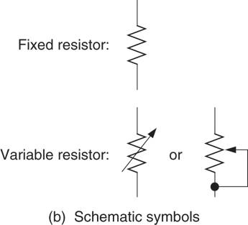
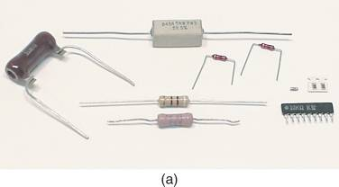
Dirençler
Direnç akımı ya da elektriğin akışını sınırlamak için kullanılan devre elemanıdır.
Dirençler

Slide 5
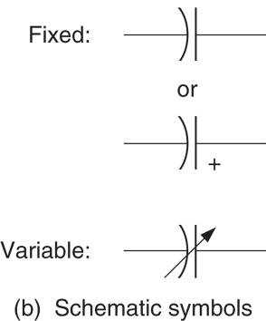
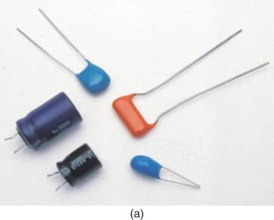
Kondansatörler
A Kondansatör, bir elektrik alan içinde enerji depolayan bir bileşendir. Kondansatörler çeşitli devrelerde kullanılmaktadır.
Kondasatör çeşitleri

Slide 6
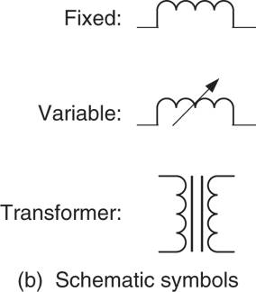
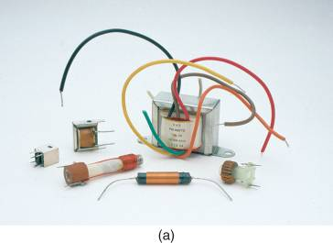
Bobinler
BOBİN manyetik alanda enerji depolayan devre bileşenidir.
Bobin ve Kondansatörlerin her ikisi de enerji depolamalarına rağmen yapıları ve karakteristikleri oldukça farklıdır.
Bobinler genellikle endüktans olarak da adlandırılırlar.

Slide 7
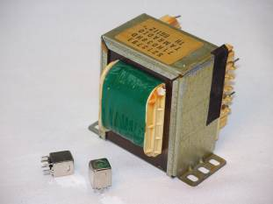
Transformatörler
TRANSFORMATÖRLER bir nüve (çekirdek) etrafına sarılmış bir veya birden fazla bobinden oluşmaktadır.
Transformatörler gerilimleri değiştirmek ve elektrik enerjisini bir devreden başka bir devreye transfer etmek (iletmek) için kullanılır.
GERİLİM DÜŞÜRÜCÜ (STEP-DOWN) TRANSFORMATÖRLER : Gerilimi daha düşük seviyelere azaltan transformatörler.
GERİLİM YÜKSELTİCİ (STEP-UP) TRANSFORMATÖRLER:
Gerilimi daha yüksek seviyelere çıkartan transformatörler.

Slide 8
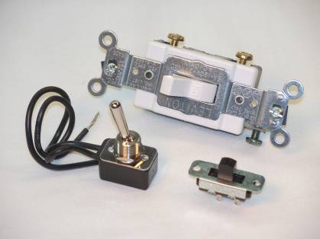
Anahtarlar
ANAHTARLAR elektrisel bağlantıyı sağlamak ya da koparmak içim kullanılan devre elemanı.

Slide 9
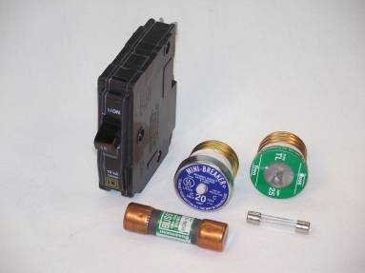
Sigortalar ve Devre kesiciler
Sigorta ve Devre kesiciler devre ve cihazları yüksek akımdan koruyan yüksek akım koruma cihazlarıdır (over current protective
devices (OCPD) )
SİGORTA– belirli bir değerin ötesindeki elektrik akım akışı karşısında otomatik olarak elektrik bağlantısını kesen bir bileşenidir.
DEVRE KESİCİLER- Bir akım yolunu kestikten sonra tekrar resentlenip kullanılabilen devre bileşenleridir.

Slide 10
TEST CİHAZLARI
Devre arızaları kolaylıkla bulunamadığı ve devre arızalarının tespiti için oldukça geniş yelpazedeki test cihazları devrede elemanlar üzerine düşen değerleri ölçmek ve devredeki sorunların tespiti için kullanılır.
Bazı örnekler:
Dijital Multimetreler Digital Multimeters (DMMs /AVOmetreler)
Volt-Ohm-Miliamper metreler (Volt-Ohm-Milliammeters (VOMs))
Frekans sayıcılar ve Frekans Jeneratörleri (Frequency Counters & Frequency Generators)
Osiloskoplar (Oscilloscopes)

Slide 11
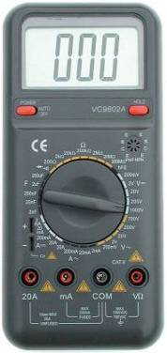
Dijital Multimetreler (Digital Multimeter (DMM))
DİJİTAL MULTİMETLER – Elektrikteki en temel üç temel özelliği ölçer: gerilim (voltage), Akım (current), ve direnç (resistance).
Bazıları kapasite, frekans gibi diğer değerleri de ölçebilir.
Dijital Multimetre Courtesy of Altadox, Inc. (www.altadox.com)

Slide 12
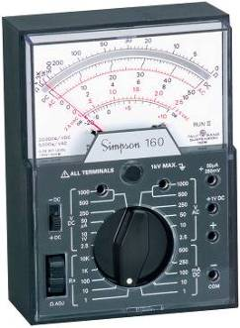
Volt-Ohm-Milliammeter (VOM)
A volt-ohm-milliammeter (VOM). Photo courtesy of Simpson Electric Co.
VOLT-OHM-MILLIAMMETER (VOM) – Dijital gösterim yerine Analog skala kullanarak okuma sağlayan ölçü aletidir.

Slide 13
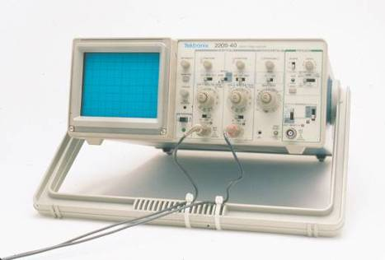
Osiloskoplar
Osilaskop. (Tektronix)
OSİLOSKOP - gerilim ve zaman ölçümleri için görsel bir görüntü sağlar test ekipmanıdır.

Slide 14
Ölçü birimleri
Yükseklik metre, Ağırlık gram / kilogram cinsinden ölçülmektedir.
Elektriksel özelliklerinde bir takım ölçüm birimleri vardır.

Slide 15
MÜHENDİSLİK NOTASYONU
ENGINEERING NOTATION – Büyük ve küçük sayıları ifade daha kolay bir kısa yolu. Üslü sayıları ifade etmek için ön ekler kullanılır.
Örneğin, 1000 metre is bir kilometre.
Kilo 1000 yerine geçer
Bu kısaltmaları sıklılıkla kullancağız.

Slide 16
MÜHENDİSLİK NOTASYONU
Ön ekler, sembol and üslüler yukarıdaki tabloda yer almaktadır.

Slide 17
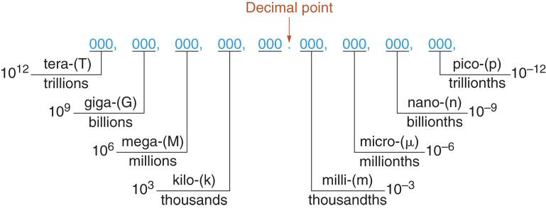
MÜHENDİSLİK NOTASYONU
Ön ekler, sembol and üslüler farklı gösterlimleri

Slide 18
Notasyon Dönüşümleri
Bir sayıyı dönüştürmek için, sadece istenilen önek için dönüşüm faktörü ile sayısına bölün.
5860 hertz (Hz)’i kilohertz’e (kHz) dönüştürmek için. kilo (k) için dönüşüm faktörü 1000 dir. Böylece,

Slide 19
Notasyon Dönüşümleri
Sometimes it is easier to convert using the exponent associated with the prefix instead of the number.
To convert 84,450,000 watts (W) to megawatts (MW). The conversion factor for mega (M) is 10⁶. Therefore,

Slide 20
Notasyon Dönüşümleri
Another example converting a number to engineering notation using the exponent is shown below.
To convert 0.00346 amperes (A) to milliamperes (mA). The conversion factor for milli (m) is 10⁻³. Therefore,

Slide 21
Notasyon Dönüşümleri
To convert a number to standard notation from engineering notation, simply multiply the value by the conversion factor of the prefix.
To convert 6.8 megohms (M) to ohms (). The conversion factor for mega (M) is 10⁶. Therefore,

Slide 22
Notasyon Dönüşümleri
Another example converting a number to standard notation from engineering notation, is shown below.
To convert 33 microfarads (μF) to farads (F). The conversion factor for micro () is 10⁻⁶. Therefore,

Slide 23
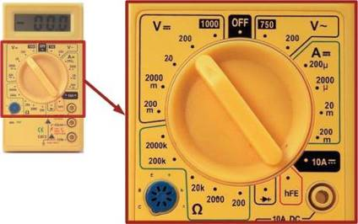
Uygulama: Ölçü aleti skalası
FONKSİYON SEÇİMİ -
Skala Multimetrenin gerilim mi (V), akım mı (A) ya da direnç mi (Ω) ölçüm yapılacağını belirler.
Mühendislik Notasyonları dijital ölçü aletleri ve displaylerinde karşınıza çıkacaktır.

Slide 24
Matter and Elements
Matter describes anything that has mass and occupies space.
Matter can exist as a solid, liquid, or gas.
An element is a substance that cannot be broken down into simpler substances.
Carbon is an element, but carbon-dioxide is not. It is comprised of two elements, carbon and oxygen.

Slide 25
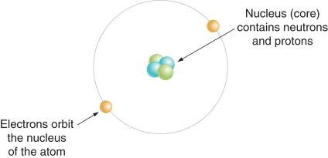
Atoms
The atom is the smallest particle of matter that retains the characteristics of the element.
Atoms are made up of a nucleus (protons and neutrons) orbited by electrons.
In its natural state, the number of protons equals the number of electrons in an atom.
The orbital paths of the electrons are called shells.
The outermost shell is called the valence shell.
A complete valence shell has 8 electrons.

Slide 26
Electrical Charge
Charge is a force that causes particles to be attracted to, or repelled by each other.
The two types of charge:
Positive charge: Protons have positive charge
Negative charge: Electrons have negative charge.

Slide 27
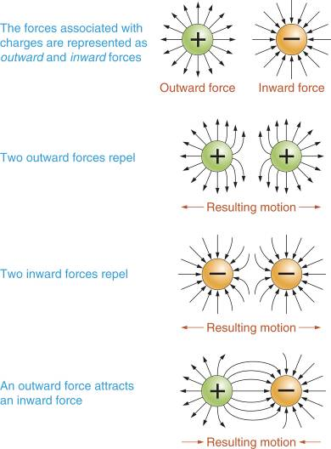
Attraction and Repulsion
Like charges repel each other.
Opposite charges attract.
If an atom loses an electron, due to some outside force it becomes a positive ion.

Slide 28
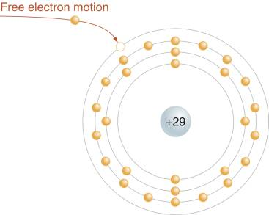
Free Electrons
An electron that breaks free of an atom is called a free electron.
If it drifts near a positive ion it is attracted by the net positive charge.
It falls into the hole in the valence band and neutralizes the ion.

Slide 29
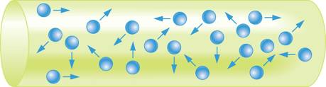
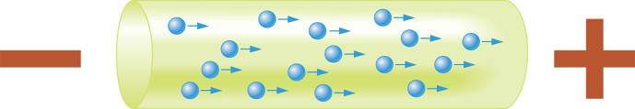
Current
With no outside directing force, free electrons move randomly.
If an outside force causes electrons to move in the same direction, this movement is called current.

Slide 30
Coulombs and Amperes
The coulomb (C) is the unit of charge.
The ampere (A) is the unit of current.

Slide 31
Current, Coulombs and Time
Current is the number of coulombs of charge that pass a given point per second.
Where
I = current in amperes
Q = charge in coulombs
t = time in seconds
In practice current is not calculated using coulombs and seconds.

Slide 32
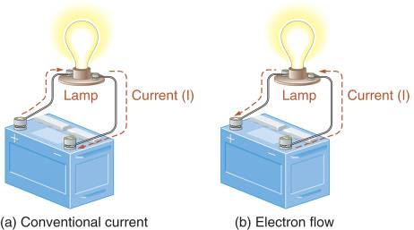
Conventional Current and Electron Flow
Conventional current defines current as the flow of charge from positive to negative.
Electron flow defines current as the flow of charge from negative to positive.

Slide 33
Direct Current (DC) Versus Alternating Current (AC)
Direct current is unidirectional.
It always travels in the same direction
It can change in value but not in direction.
Alternating current is bidirectional
It periodically changes direction.

Slide 34
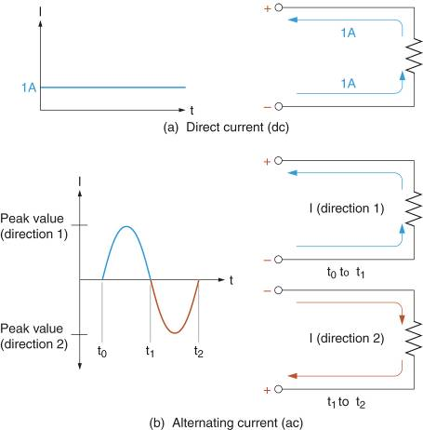
Comparing AC and DC
This figure compares AC and DC current.

Slide 35
Current Produces Heat
Whenever there is current through a component or circuit, heat is produced.
This why some machines, like motors, get hot.
Heat can be a desirable thing (like in a stove element).

Slide 36
Voltage
Voltage is a force that produces current through a circuit.
A voltage source will have a positive terminal and a negative terminal.
The positive terminal has an excess of positive ions.
The negative terminals has an excess of electrons.
This results in a potential difference between the terminals.

Slide 37
Voltage (continued)
Since voltage is a force that moves electrons, it is often referred to as:
Electrical force (E), or
Electromotive force (EMF)
The Volt is the unit of measure for voltage.
It is defined in terms of energy in joules and charge in coulombs.
1 V = 1 J/C

Slide 38
Resistance
All elements provide some opposition to current.
This opposition is referred to as resistance.
Resistance (R) is measured in Ohms (Ω).
1 ohm is the resistance that limits current to 1 ampere when 1 volt is applied.
1 Ω = 1 V/1 A

Slide 39
Current, Voltage, and Resistance
This table summarizes the relationship among current, voltage, and resistance.
Property | Units | Description
Charge (Q) | Coulombs (C)
Current (I) | Amperes (A) | The flow of charge. 1 A = 1 C/s
Voltage (E or V) | Volts (V) | Electrical force. 1 V = 1 J/C
Resistance (R) | Ohms (Ω) | Opposition to current. 1 Ω = 1 V/1 A

Slide 40
Conductors, Insulators, and Semiconductors
Conductors provide little opposition to current.
Conductors usually have one valence electron.
They have a high density of atoms per unit volume.
Insulators normally block current.
Insulators have complete valence shells (8 electrons).
The have few atoms per unit volume than conductors.
Semiconductors are neither good conductors nor good insulators.
They usually have 4 valence electrons.

Slide 41
Conductors, Insulators, and Semiconductors
The table below contrasts conductors, insulators and semiconductors.
Material | Characteristics
Conductor | Extremely low resistance. Conducts current easily with little voltage applied.
Insulator | Extremely high resistance. Conducts current only when a very high voltage is applied.
Semiconductor | Resistance is between that of a conductor and an insulator. Limits current for a given voltage.

Slide 42
Conductor Resistance
The resistance of a conductor depends on:
The resistivity of the conductor.
The length of the conductor
The cross-sectional area of the conductor.

Slide 43
Calculating Resistance
When the length and cross-sectional area of a conductor is known, its resistance is calculated using,
This equation show us that resistance is
Directly proportional to resistivity
Directly proportional to length
Inversely proportional to cross-sectional area

Slide 44
Temperature and Resistance
The resistivity of a conductor is affected by temperature.
If its resistance increases with temperature, it has a positive temperature coefficient.
If its resistance decreases with temperature, it has a negative temperature coefficient.
Conductors have a positive temperature coefficient.

Slide 45
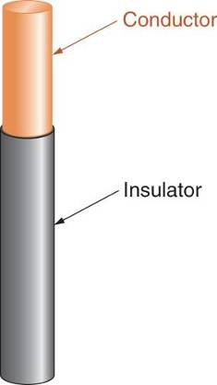
Conductors and Insulators
Any current-carrying conductor must be kept from contacting anything or anyone around it.
This is accomplished by coating the conductor with an insulating material.

Slide 46
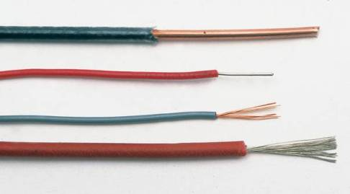
Copper Wires
Copper is the most common wire material.
Copper wires are either solid or stranded.
Solid wires are easier to produce
Stranded wire is more flexible.

Slide 47
Why is Copper Used?
Copper is the best compromise between resistivity and cost.
Silver has better resistivity but is too expensive.
Aluminum is cheaper but it has poor elasticity.
This can cause problems when connected to copper connectors.
Even so, aluminum, and copper-clad aluminum wire is still commonly used.

Slide 48
Wire Sizes
The size of wire is determined by its cross-sectional area.
The American Wire Gauge (AWG) system uses numbers, or thousands of circular mils (KCMIL) to identify the wire size.

Slide 49
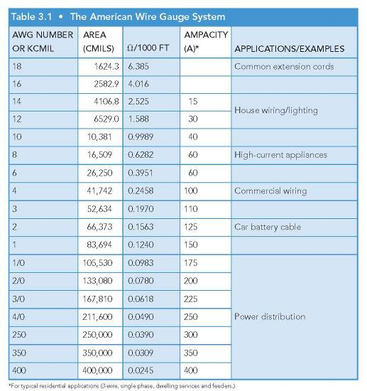
The American Wire Gauge System

Slide 50
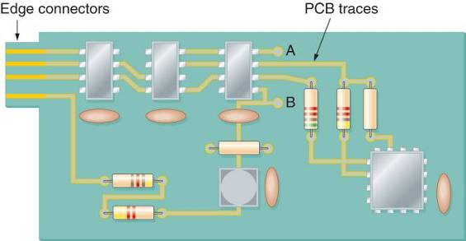
PC Board Traces
Many electronic circuits are built on printed-circuit (PC) boards.
The conductors on a PC board all called traces.

Slide 51
Insulator Average Breakdown Voltage
Any insulator can be forced to conduct if enough voltage is applied.
The average breakdown voltage rating of an insulator is the voltage that will cause the insulator to conduct, in kilovolts per centimeter (kV/cm).

Slide 52
Some Average Breakdown Voltage Ratings
MATERIAL | AVERAGE BREAKDOWN VOLTAGE RATING
Air | 30 kV/cm
Rubber | 270 kV/cm
Paper | 500 kV/cm
Teflon | 600 kV/cm
Glass | 900 kV/cm
Mica | 2000 kV/cm

Slide 53
Resistors
Resistors are components with a specific amount of resistance.
They are classified as fixed or variable.
A fixed resistor has a specific value that cannot be changed.
A variable resistor is one that can be adjusted within a specified range.

Slide 54
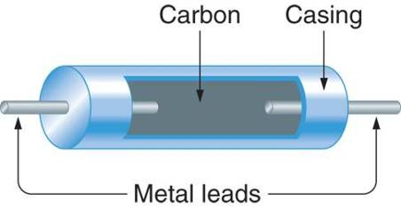
Carbon-Composition Resistors
Carbon-composition resistors are very common.
Two metal leads are separated by a section of carbon.
The resistance is determined by the purity of the carbon.

Slide 55
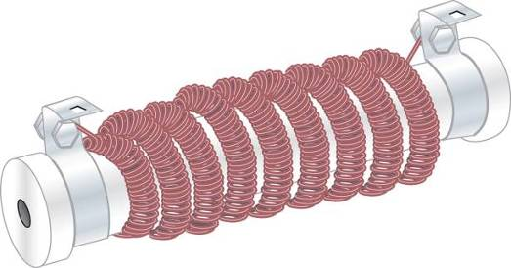
Wire-Wound Resistors
Wire-wound resistors use the length of the wire to determine its resistance.
They are used in high-power applications.

Slide 56
Integrated Resistors
Integrated resistors are micro-miniature components that are constructed using semi-conductor materials other than carbon.
Several resistors are often found in a single package.
They are usually restricted to low-power applications.

Slide 57
Standard Resistor Values

Slide 58
Resistor Tolerance
No resistor is perfect.
Its actual resistance will fall within a certain range of resistance values.
This range of resistance values is called the tolerance of the component.
It is expressed as a percentage of the rated (nominal) value.
For example, a 330 Ω resistor with a 2% tolerance can vary by
This means that the actual resistance will fall within the range of 336.6 Ω to 323.4 Ω.

Slide 59
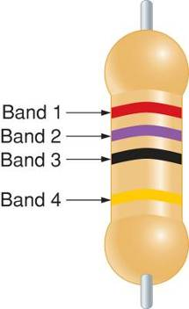
Resistor Color Code
In most cases, the value of a resistor is indicated by a series of color bands.
Band 1 is the first digit
Band 2 is the second digit
Band 3 is the multiplier
Band 4 is the tolerance

Slide 60
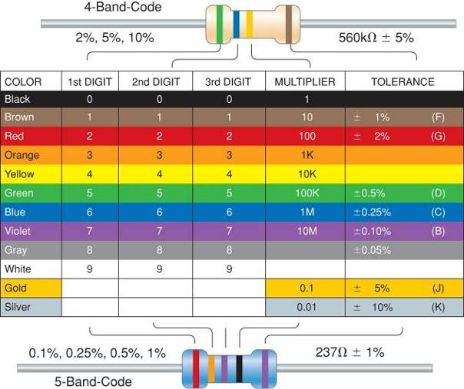
Resistor Color Code (continued)

Slide 61

Resistor Color Code (continued)
This resistor’s color bands are: orange = 3 blue = 6 brown = 1
The resistance value equals

Slide 62

Resistor Tolerance Band
The fourth band on the resistor is the tolerance band.
For a four-band resistor, the tolerance bands are
Red = 2%
Gold = 5%
Silver = 10%
For the resistor shown, the band is gold so the tolerance is 5%.

Slide 63
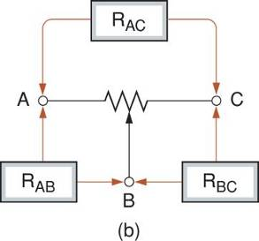
Potentiometers
A potentiometer is a 3-terminal resistor whose value can be adjusted by the user.
The resistance between the middle terminal, called the wiper arm, and the two outer terminals changes as the shaft is rotated.
Standard terminal and resistance designations are shown in the figure.

Slide 64
Potentiometers (continued)
Although the resistance between the center terminal and the outer terminals changes as the shaft rotates, the resistance between the outer terminals does not.
This relationship can be expressed as
R_{AC} = R_{AB} + R_{BC}

Slide 65
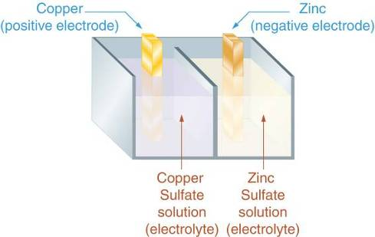
Batteries
A battery is made up of one or more cells.
Each cell has an electrode surrounded by a chemical agent called an electrolyte.

Slide 66
Batteries (continued)
The chemical reaction between the electrode and the electrolyte results in the electrode either gaining or losing electrons.
This results in a potential difference (voltage) between the electrodes.
A battery may contain one or more cells depending on the voltage rating of the battery.

Slide 67
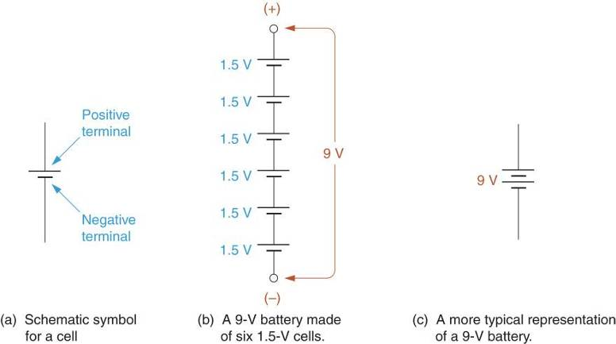
Batteries Schematic Symbols

Slide 68
Battery Capacity
Battery capacity is the measure of how long a battery can maintain its voltage at a given current.
It is measured in ampere-hours (Ah).
The product of current and time (in hours) equals the Ah rating of the battery
For example, if an AA-cell battery can maintain its 1.5 V rating for 9.6 hours @ 250 mA, it has a capacity of,

Slide 69
Types of Battery Cells
There are two types of cells.
Primary Cells: The chemical reaction in primary cells causes permanent changes. They cannot be recharged. They are also called dry cells.
Secondary Cells: These cells can be recharged by forcing a current through the cell in the opposite direction of normal cell current. They are also called wet cells.

Slide 70
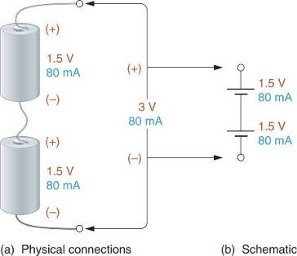
Batteries in Series
Batteries are connected in series to increase total circuit voltage.
Maximum current is still equal to the current rating of each individual battery.

Slide 71
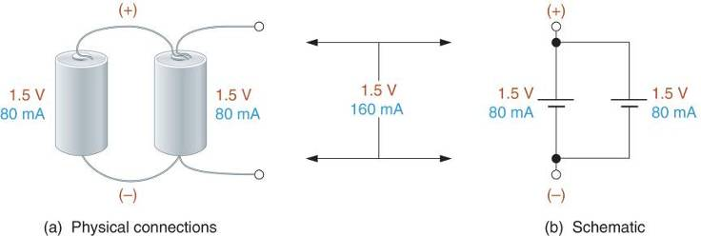
Batteries in Parallel
Batteries are connected in parallel to increase total circuit current.
Maximum voltage is still equal to the voltage rating of each individual battery.

Slide 72
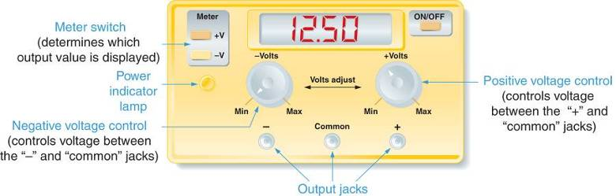
Variable DC Power Supplies
One common source of DC voltage is the variable DC power supply.
The DC outputs can be adjusted to any value within its design limits.

Slide 73
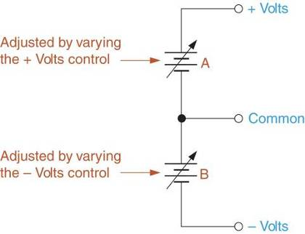
Positive and Negative Voltages
A DC power supply can supply voltages that are either positive or negative with respect to the common terminal.
The common terminal is the reference point.
All voltages are determined to be either positive or negative with respect to some reference.
The positive or negative designation is referred to as polarity.

Slide 74
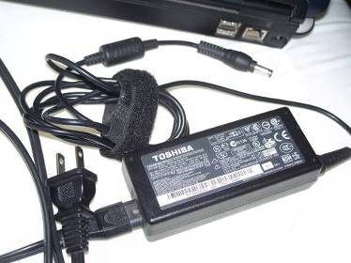
AC Adapters
AC adapters are components that convert AC (line) voltage into some fixed value of DC voltage.
They are usually rated at some DC voltage at a specified current.

Slide 75
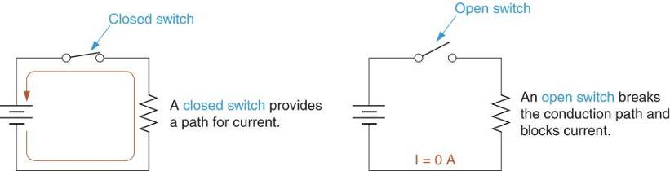
Switches
A switch allows you to manually make or break a connection in a circuit.

Slide 76
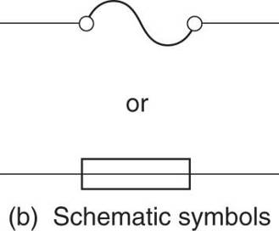
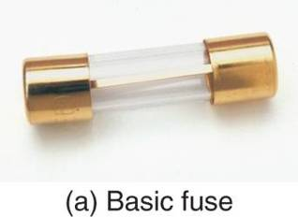
Fuses
Fuses are circuit protection devices.
They act like normally closed switches until circuit current exceeds a specified value.

Slide 77
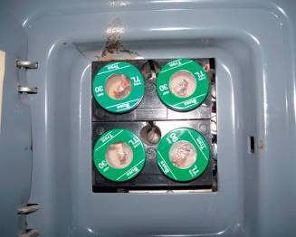
Electrical Fuses
Electrical fuses are contained in a fuse box.
They connect the AC line voltage to the rest of the circuit.

Slide 78
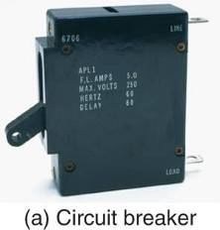

Circuit Breakers
Circuit breakers are circuit protectors, just like fuses.
Unlike fuses, once they open, they can be reset and used again.

Slide 79
Multimeters
A multimeter is an instrument used to measure voltage, current, and resistance.
Some meters can measure other values like capacitance.
There are two types of multimeters:
Analog meters use a pointer that moves across a fixed scale to produce a reading.
Digital meters use a digital readout display.

Slide 80
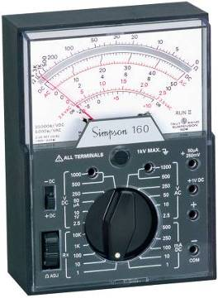
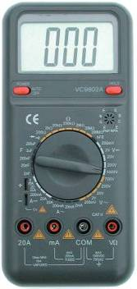
Analog and Digital Meters
Analog and digital multimeter displays.

Slide 81
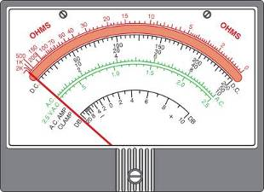
Reading an Analog Meter Display
An analog display contains several scales for displaying different measured values.
The top scale (red) is for resistance values.
The middle scale (black) is for DC values.
The bottom scale (green) is for AC values.

Slide 82
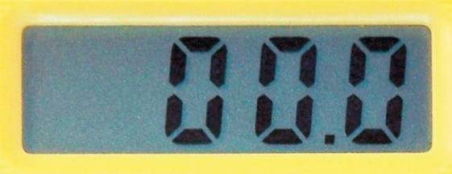
Digital Displays
Digital displays are much simpler to read.
Parallax error is not an issue.
You simply set the selector switch to the desired measurement and range, and then read the value on the display.

Slide 83
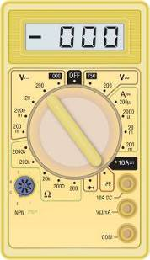

Multimeters
A digital multimeter is usually referred to as a DMM.
An analog multimeter is called a VOM for volt-ohm-milliameter.

Slide 84
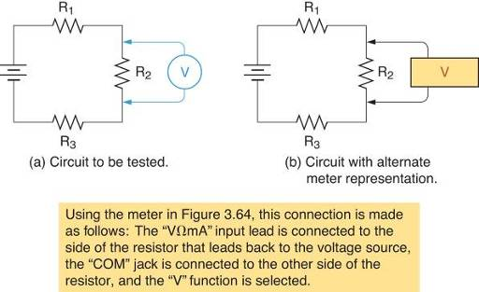
Measuring Voltage
Voltage is measured across a component.
When using a VOM to measure DC volts, make sure the polarity is correct.

Slide 85
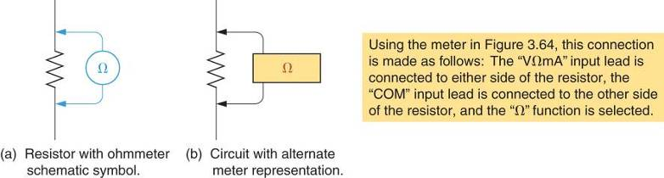
Measuring Resistance
Resistance is measured across the component like voltage.
Unlike voltage measurements, resistance is measured with the power off.

Slide 86
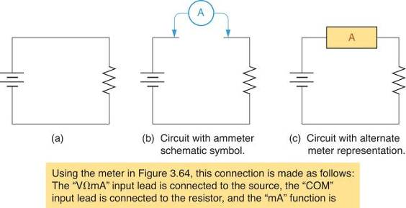
Measuring Current
Current must be measured by inserting the meter in the current path.
This often means breaking the current path and inserting the meter.

Slide 87
Ohm’s Law
Georg Simon Ohm, a German physicist, identified several cause-and-effect relationships between circuit current, voltage, and resistance.
Ohm stated that current is directly proportional to voltage and inversely proportional to resistance.

Slide 88
Ohm’s Law
Ohm’s law can be stated mathematically as
where
I = the circuit current
E = the applied voltage
R = the circuit resistance

Slide 89
Two statements we can derive from Ohm’s law are:
1. The current through a fixed resistance:
a. increases when the applied voltage increases.
b. decreases when the applied voltage
decreases.
2. The current generated by a fixed voltage:
a. decreases when the resistance increases.
b. increases when the resistance decreases.

Slide 90


The Relationship Between Current and Voltage
If voltage increases, current will increase if resistance remains constant.
The greater the voltage, the higher the current for any fixed resistance.

Slide 91


The Relationship Between Current and Resistance
If resistance increases, current will decrease if voltage remains constant.
If resistance decreases, current will increase if voltage remains constant.

Slide 92

Using Ohm’s Law to Calculate Current
Ohm’s law can be used to calculate current in this circuit as

Slide 93

A Practical Application
The DC power supply has a maximum output of 200 V. Will the fuse blow?
We solve for current as
The fuse will blow.

Slide 94

Using Ohm’s Law to Calculate Voltage
Ohm’s law can be used to calculate voltage in this circuit as

Slide 95
A Practical Application
Two 6 Ω speakers draw 2.08 A each from a DC power supply. Solve for the source voltage.
The source voltage is found as

Slide 96

Using Ohm’s Law to Calculate Resistance
Ohm’s law can be used to calculate resistance in this circuit as

Slide 97

A Practical Application
Solve for the minimum allowable rheostat setting that will not cause the fuse to blow.
The minimum resistance is found as

Slide 98

Current and Voltage
Current is directly proportional to voltage.
If voltage triples:
Current triples if voltage triples.
It is directly proportional to voltage.

Slide 99

Current and Resistance
Current is inversely proportional to resistance.
If resistance triples
Tripling the resistance caused current to drop to 1/3 of its original value.

Slide 100



Ohm’s Law Wheel
Cover the value of interest to see the correct equation.

Slide 101
Summary of Ohm’s Law Relationships
This table summarizes the Ohm’s law relationships between voltage, current and resistance.

Slide 102
Power
Power is the rate at which energy is used per unit time.
The unit of measure is the Watt.
The watt is defined in terms of energy in joules and time in seconds.
1 watt = 1 joule per second

Slide 103
Calculating Power
The ampere is defined as
1 A = 1 coulomb per second
The volt is defined as
1 V = 1 joule per coulomb
If we multiply amperes times volts, the results is in joules per second, the unit of measure for power.

Slide 104

Watt’s Law
One form of Watt’s law can be stated as
For the circuit shown,

Slide 105

Watt’s Law (continued)
Another form of Watt’s law is
For the circuit shown,

Slide 106

Watt’s Law (continued)
The third form of Watt’s law is
For the circuit shown,

Slide 107


Slide 108


Slide 109
Measuring Circuit Current
In order to measure current, the ammeter must be in the current path.
One way to do this is to connect the ammeter across an open switch.

Slide 110
Measuring Source Voltage
Source voltage is measured by connecting a voltmeter across the source.

Slide 111
Measuring Source Voltage
Source voltage is measured by connecting a voltmeter across the source.

